Slide 1

COMP1631 Advanced Spreadsheets – Winter 2024 – Section 06
Module 5

Slide 2



COMP1631 Advanced Spreadsheets – Winter 2024 – Section 06
Lecture 2 Tuesday, January 16, 2024
Today’s menu a la carte
Apéritifs
Module 5 Objectives
Plat principal
Quick check quiz
Review Modules 5
Desserts
Module 5 Textbook Project

Slide 3
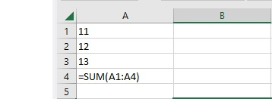
COMP1631 Advanced Spreadsheets – Winter 2024 – Section 06
Before we start
Quick Quiz from last class:
1. What is wrong with the formula shown?

Slide 4
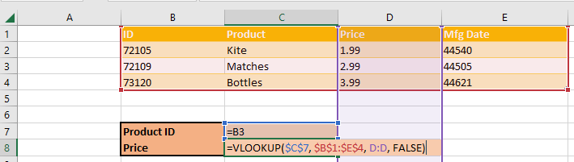
COMP1631 Advanced Spreadsheets – Winter 2024 – Section 06
Before we start
Quick Quiz from last class:
2. Correct the given VLOOKUP formula according to information shown?

Slide 5
COMP1631 Advanced Spreadsheets – Winter 2024 – Section 06
Module Objectives
Section 5.1
Copy worksheets between workbooks
View a workbook in multiple windows
Organize worksheets in a worksheet group
Write a 3-D reference
Section 5.2
Write an external reference
Manage the security features of linked documents
Create a hyperlink to a document source
Link to an email address
Section 5.3
Create and apply a named range
Work with name scope
Create a workbook template

Slide 6
COMP1631 Advanced Spreadsheets – Winter 2024 – Section 06
Working with Multiple Worksheets.
A workbook can contain one or several worksheets. This feature gives you the ability to organize your data better.
Many times a workbook has a massive amount of data. By dividing that data up into worksheets it is much more manageable and accessible.
Often times, a worksheet at the front of the workbook will summarize the data on the rest of the worksheets. This provides an opportunity to view summarized data without having to look at the rest of the data unless you want to.

Slide 7
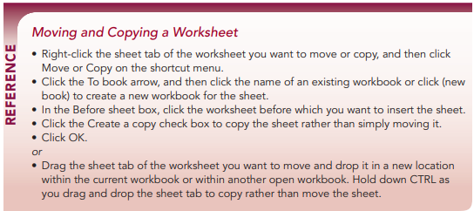
COMP1631 Advanced Spreadsheets – Winter 2024 – Section 06

Slide 8
COMP1631 Advanced Spreadsheets – Winter 2024 – Section 06
Quick Quiz:
What is the first step in copying worksheets to another workbook?
True/False. The fastest way to copy an entire worksheet to press and hold the Alt key as you drag and drop the sheet tab.

Slide 9
COMP1631 Advanced Spreadsheets – Winter 2024 – Section 06
Quick Quiz:
What is the first step in copying worksheets to another workbook?
(Answer: select the sheet tabs you want to copy)
False. The fastest way to copy an entire worksheet to press and hold the Alt key as you drag and drop the sheet tab.

Slide 10
COMP1631 Advanced Spreadsheets – Winter 2024 – Section 06
Viewing a Workbook in Multiple Windows:
You should know
How to arrange multiple workbook windows …
How to synchronize scrolling between windows …

Slide 11
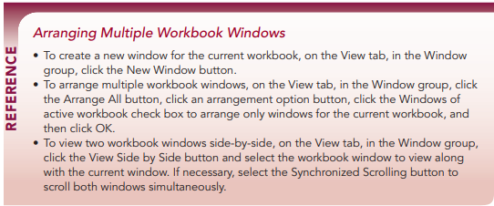
COMP1631 Advanced Spreadsheets – Winter 2024 – Section 06

Slide 12
COMP1631 Advanced Spreadsheets – Winter 2024 – Section 06
Quick Quiz:
Match the correct layout option with what it does
Cascade
Horizontal
Vertical
Tiled
layers the windows in an overlapping stack.
expands the height of the windows to fill the screen and places them in a single row.
resizes the height and width of windows to fill the screen in both horizontal and vertical directions like floor tiles.
expands the width of the windows to fill the screen and places them in a single column.

Slide 13
COMP1631 Advanced Spreadsheets – Winter 2024 – Section 06
Quick Quiz:
Match the correct layout option with what it does (Answered):
Cascade
layers the windows in an overlapping stack.
expands the height of the windows to fill the screen and places them in a single row.
resizes the height and width of windows to fill the screen in both horizontal and vertical directions like floor tiles.
expands the width of the windows to fill the screen and places them in a single column.
Vertical
Tiled
Horizontal

Slide 14
COMP1631 Advanced Spreadsheets – Winter 2024 – Section 06
2. Quick Quiz:
True or False: You can synchronize scrolling in two windows that are viewed side by side.

Slide 15
COMP1631 Advanced Spreadsheets – Winter 2024 – Section 06
2. Quick Quiz:
True: You can synchronize scrolling in two windows that are viewed side by side.

Slide 16
COMP1631 Advanced Spreadsheets – Winter 2024 – Section 06
Working with Worksheet Groups
You should know:
How to edit worksheet groups.
How to ungroup a worksheet.
How to print a worksheet group.

Slide 17
COMP1631 Advanced Spreadsheets – Winter 2024 – Section 06
Working with Worksheet Groups
A worksheet group is a collection of two or more worksheets. Grouping worksheets allows students to apply formulas across the worksheets in the group.
Can also apply formatting across worksheets in a group. This allows us to work more efficiently by making multiple changes through a single change.
Any changes made to one worksheet will also be changed in any other worksheets in the group. This is a great way to apply formatting across worksheets. However, a common error is to delete a value or change a value in a worksheet not intending to have that change made in all the worksheets.
Remove the grouping before we begin to make individual worksheet changes.

Slide 18
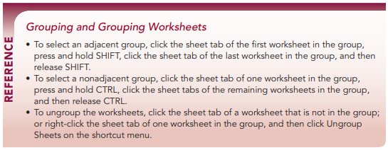
COMP1631 Advanced Spreadsheets – Winter 2024 – Section 06

Slide 19
COMP1631 Advanced Spreadsheets – Winter 2024 – Section 06
3. Quick Quiz:
True/False: When you edit cells in a worksheet group, the changes you make to one worksheet are automatically applied to the other worksheets in the group.
How do you ungroup worksheets?
To print the grouped worksheets, first do what?
True/False: In a worksheet group, changing row heights, but not row widths, are automatically applied to all sheets.
True/False: Worksheet groups save time and improve consistency.

Slide 20
COMP1631 Advanced Spreadsheets – Winter 2024 – Section 06
3. Quick Quiz:
True: When you edit cells in a worksheet group, the changes you make to one worksheet are automatically applied to the other worksheets in the group.
How do you ungroup worksheets?
(Answer: Click the sheet tab of a worksheet that is not part of the group. If a worksheet group includes all of the sheets in a workbook, click any of the sheet tabs to ungroup the worksheets.)
To print the grouped worksheets, first do what?
(Answer: Group the sheets to be printed.)
False: In a worksheet group, changing row heights, but not row widths, are automatically applied to all sheets.
True: Worksheet groups save time and improve consistency.

Slide 21
COMP1631 Advanced Spreadsheets – Winter 2024 – Section 06
Writing 3-D References
You should know:
How to reference cells in other worksheets
How to apply 3-D references to formulas and functions

Slide 22
COMP1631 Advanced Spreadsheets – Winter 2024 – Section 06
Writing 3-D References
Familiar with the two-dimensional aspect of a worksheet (i.e., rows and columns).
Think of the collection of worksheets in a workbook as a third dimension.
Can reference rows and columns in a worksheet, and can also reference cells in other worksheets. Therefore, have a reference in a worksheet that pertains to a cell in another worksheet.

Slide 23
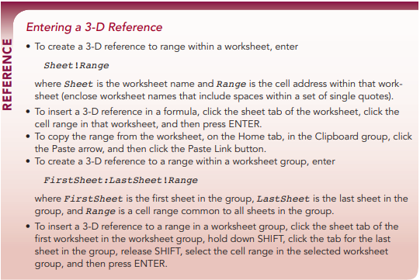
COMP1631 Advanced Spreadsheets – Winter 2024 – Section 06

Slide 24
COMP1631 Advanced Spreadsheets – Winter 2024 – Section 06
Quick Quiz:
What is a 3-D reference?
True/False: 3-D references can only be used within certain Excel formulas and functions. True/False: Worksheet group references are based on the current order of worksheets in the workbook. True/False: A 3-D reference can be used with MIN and MAX functions.
True/False: A 3-D reference cannot be used with COUNT and AVERAGE functions. A ________ is a symbol that represents any character.

Slide 25
COMP1631 Advanced Spreadsheets – Winter 2024 – Section 06
Quick Quiz:
What is a 3-D reference?
(Answer: It refers to the same cell or range in multiple worksheets in the same workbook.)
False: 3-D references can only be used within certain Excel formulas and functions.
True: Worksheet group references are based on the current order of worksheets in the workbook.
True: A 3-D reference can be used with MIN and MAX functions.
False: A 3-D reference cannot be used with COUNT and AVERAGE functions.
A ________ is a symbol that represents any character.
(Answer: wildcard)

Slide 26
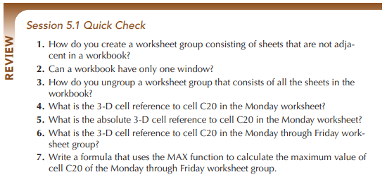
COMP1631 Advanced Spreadsheets – Winter 2024 – Section 06

Slide 27
COMP1631 Advanced Spreadsheets – Winter 2024 – Section 06
Linking to External Workbooks
You should know:
How to create external references.
How to update workbook links.
External references and security concerns.
How to review links within a workbook.
How to manage workbook links.

Slide 28
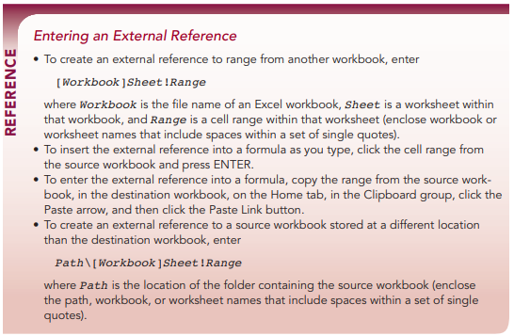
COMP1631 Advanced Spreadsheets – Winter 2024 – Section 06

Slide 29
COMP1631 Advanced Spreadsheets – Winter 2024 – Section 06
Quick Quiz:
True/False. When you break a link using the Break Links command in the Edit Links dialog box, all the external reference formulas are converted to their most recent values.
References to cells in other workbooks are also known as ___________ references.
How do you reference cells within a worksheet group of the source workbook?
True/False: External references can be long and complicated.
True/False: When linking to external source documents, you do not have to worry about security issues

Slide 30
COMP1631 Advanced Spreadsheets – Winter 2024 – Section 06
Quick Quiz:
True. When you break a link using the Break Links command in the Edit Links dialog box, all the external reference formulas are converted to their most recent values.
References to cells in other workbooks are also known as ___________ references.
(Answer: external)
How do you reference cells within a worksheet group of the source workbook?
(Answer: place the workbook file name in brackets and then list the worksheet group and cell reference as you would in a 3-D reference)
True: External references can be long and complicated
False: When linking to external source documents, you do not have to worry about security issues.

Slide 31
COMP1631 Advanced Spreadsheets – Winter 2024 – Section 06
Creating Hyperlinks
You should know:
How to link to a location within a workbook.
How to link to an email address.

Slide 32
COMP1631 Advanced Spreadsheets – Winter 2024 – Section 06
Creating Hyperlinks
A hyperlink is a link to information within that file or another file.
The hyperlinks are usually represented by colored words with underlines or images.
Although hyperlinks are most often found on Web pages, they can also be placed in a worksheet and used to quickly jump to a specific cell or range within the active worksheet, another worksheet, another workbook, or to other files, such as a Word document or a PowerPoint presentation, or sites on the Web.

Slide 33
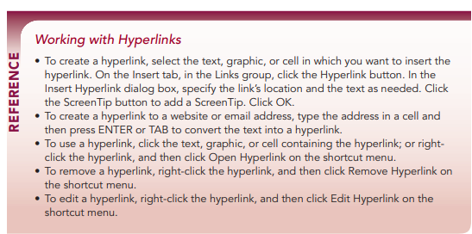
COMP1631 Advanced Spreadsheets – Winter 2024 – Section 06

Slide 34
COMP1631 Advanced Spreadsheets – Winter 2024 – Section 06
Quick Quiz:
A(n) _______ is a link in a file.
True/False. To use a hyperlink, you click anywhere inside the cell that contains the link.
Name five resources that a hyperlink can be connected to.

Slide 35
COMP1631 Advanced Spreadsheets – Winter 2024 – Section 06
Quick Quiz:
A(n) _______ is a link in a file.
(Answer: hyperlink)
False. To use a hyperlink, you click anywhere inside the cell that contains the link.
Name five resources that a hyperlink can be connected to.
(Answer: Websites; files on your computer in Word documents, PowerPoint presentations, text files, and PDF documents; cells and cell ranges within the current workbook; email addresses; new documents created specifically as the source of the hyperlink.)

Slide 36
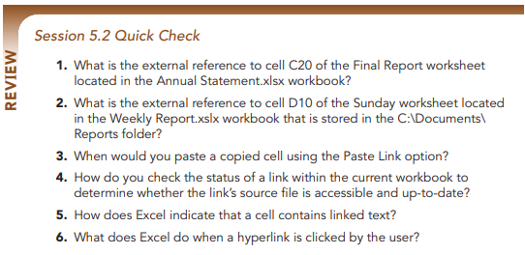
COMP1631 Advanced Spreadsheets – Winter 2024 – Section 06

Slide 37
COMP1631 Advanced Spreadsheets – Winter 2024 – Section 06
Simplifying Formulas with Named Ranges
You should know:
What is a named range.
How to use named ranges in formulas.
How to determine the scope of named ranges.
How to use defined names in existing formulas.

Slide 38
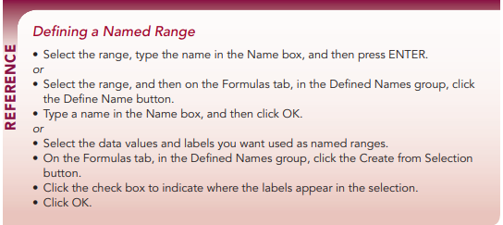
COMP1631 Advanced Spreadsheets – Winter 2024 – Section 06

Slide 39
COMP1631 Advanced Spreadsheets – Winter 2024 – Section 06
Quick Quiz:
True or False: A named range can refer to any cell or cell range within a workbook.
True or False: The least productive way to define a named range is to select a range and enter the name in the Name box.
True or False: The name you use for a range should be short, meaningful, and descriptive.
By default, Excel treats named ranges as __________ cell references
______ scope is used to avoid name conflicts that would occur when the same name is duplicated across multiple worksheets.
True or False: You can use the Apply Names command for worksheet groups.

Slide 40
COMP1631 Advanced Spreadsheets – Winter 2024 – Section 06
Quick Quiz:
True: A named range can refer to any cell or cell range within a workbook.
False: The least productive way to define a named range is to select a range and enter the name in the Name box.
True: The name you use for a range should be short, meaningful, and descriptive.
By default, Excel treats named ranges as __________ cell references.
(Answer: absolute)
______ scope is used to avoid name conflicts that would occur when the same name is duplicated across multiple worksheets.
(Answer: Local)
False: You can use the Apply Names command for worksheet groups.

Slide 41
COMP1631 Advanced Spreadsheets – Winter 2024 – Section 06
Exploring Workbook Templates
You should know:
How to set up a workbook template.
How to create a workbook based on a template.

Slide 42
COMP1631 Advanced Spreadsheets – Winter 2024 – Section 06
Exploring Workbook Templates
A custom template is a workbook template you create that is ready to run with the formulas for all calculations included as well as all formatting.

Slide 43
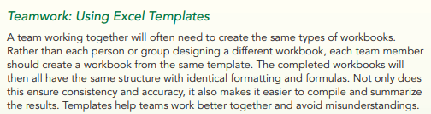
COMP1631 Advanced Spreadsheets – Winter 2024 – Section 06

Slide 44
COMP1631 Advanced Spreadsheets – Winter 2024 – Section 06
The following are just some of the advantages of using a template to create multiple workbooks with the same features:
• Templates save time and ensure consistency in the design and content of workbooks because all labels, formatting, and formulas are entered once.
• Templates ensure accuracy because formulas can be entered and verified once, and then used with confidence in all workbooks.
• Templates standardize the appearance and content of workbooks.
• Templates prevent data from being overwritten when an existing workbook is inadvertently saved with new data rather than saved as a new workbook.
If you are part of a team that needs to create the same type of workbook repeatedly, it’s a good idea to use a template to both save time and ensure consistency in the design and content of the workbooks.

Slide 45
COMP1631 Advanced Spreadsheets – Winter 2024 – Section 06
Advantages of using a template
save time and ensure consistency
ensure accuracy
standardize the appearance and content
prevent data from being overwritten

Slide 46
COMP1631 Advanced Spreadsheets – Winter 2024 – Section 06
Quick Quiz:
True/False. You can create a workbook with all the formulas and formatting you need and then save it as a template on which you can base other workbooks.
True/False: There are three ways to create a workbook based on a template.

Slide 47
COMP1631 Advanced Spreadsheets – Winter 2024 – Section 06
Quick Quiz:
True. You can create a workbook with all the formulas and formatting you need and then save it as a template on which you can base other workbooks.
False: There are three ways to create a workbook based on a template.

Slide 48
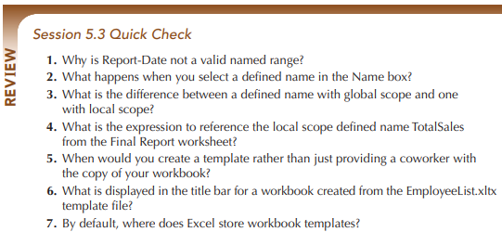
COMP1631 Advanced Spreadsheets – Winter 2024 – Section 06

Slide 49
COMP1631 Advanced Spreadsheets – Winter 2024 – Section 06

